Slide 1
TRAC / TDR
ICPSR 2012

Slide 2
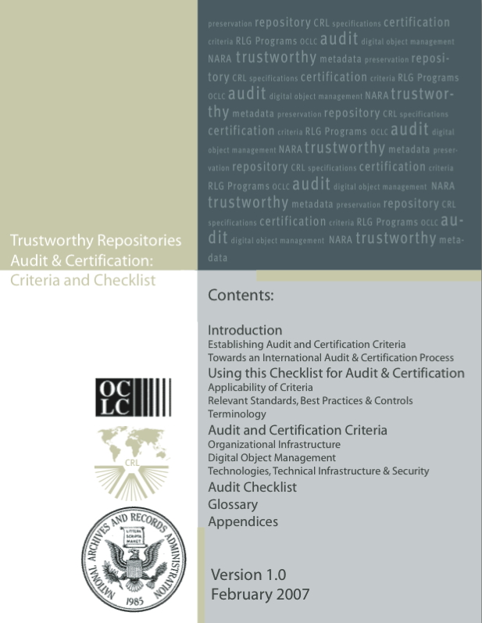
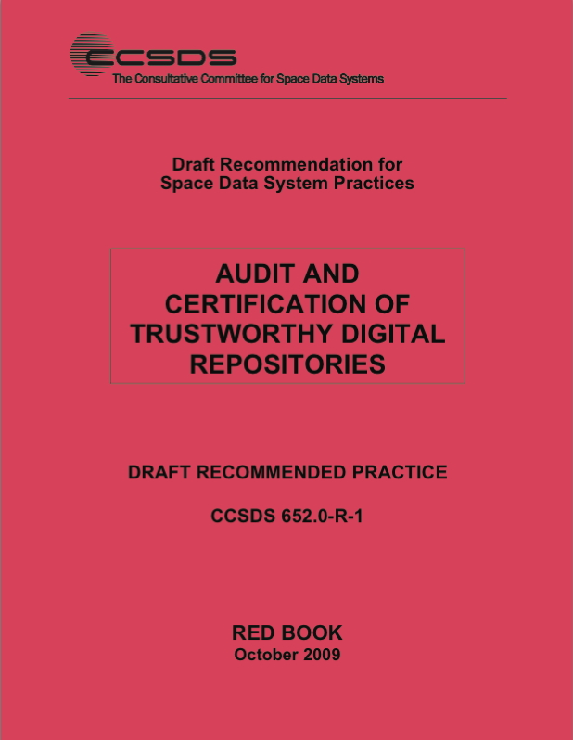
Trustworthy Digital Repositories
Notes:
You may have also heard of “TRAC.“ The “Trustworthy Repository Audit and Certification: Criteria and Checklist“ from 2007.
It was the predecessor to TDR (2009).

Slide 3
TRAC/ TDR
TRAC and TDR are checklists based on OAIS criteria.
TRAC and TDR provide a mechanism for measuring compliance of an archive with OAIS.
“Stewardship is easy and inexpensive to claim; it is expensive and difficult to honor, and perhaps it will prove to be all too easy to later abdicate”
Lynch, Clifford A. February 2003. “Institutional Repositories: Essential Infrastructure for Scholarship in the Digital Age.” ARL BiMonthly Report 226.

Slide 4
TRAC/ TDR
TRAC and TDR provide a mechanism for certifying the trustworthiness of digital archives.

Slide 5
Trustworthy Digital Repositories
Notes:
TDR, “Audit and Certification of Trustworthy Digital Repositories”… The RED Book

Slide 6
Trustworthy Digital Repositories
TDR: 2009
Based on TRAC
Developed by the Consultative Committee for Space Data Systems (CCSDS)
It is a draft Recommended Practice.
Now an draft standard: ISO/DIS 16363
Notes:
TDR is still considered a DRAFT, but it has already been through a test phase and will likely replace TRAC officially very soon.

Slide 7
TDR
Provides 109 “metrics” for measuring conformance to OAIS.

Slide 8
TDR Metrics
Metric requirement
Supporting Text
Examples of Ways the Repository Can Demonstrate It Is Meeting This Requirement
Discussion

Slide 9
3.3.5 The repository shall define, collect, track, and appropriately provide its information integrity measurements.
Supporting Text
This is necessary in order to provide documentation that it has developed or adapted appropriate measures for ensuring the integrity of its holding.
Examples of Ways the Repository Can Demonstrate It Is Meeting This Requirement
Written definition or specification of the repository’s integrity measures (for example, computed checksum or hash value); documentation of the procedures and mechanisms for monitoring integrity measurements and for responding to results of integrity measurements that indicate digital content is at risk; an audit process for collecting, tracking and presenting integrity measurements; Preservation Policy and workflow documentation.
Discussion
The mechanisms to measure integrity will evolve as technology evolves. The repository may provide documentation that it has developed or adapted appropriate measures for ensuring the integrity of its holdings. If protocols, rules and mechanisms are embedded in the repository software, there should be some way to demonstrate the implementation of integrity measures.
Notes:
The things to understand about this example are:
Not prescriptive (doesn’t say you have to use a particular measurement of integrity [e.g., MD5 hash])
It suggests ways you might document that you are meeting the requirement, but does not require any single, specific method of documenting
It requires what you are doing (the function of ensuring integrity) works. [track, audit, monitor]

Slide 10
TDR
Provides 109 “metrics” for measuring conformance to OAIS.
Metrics cover 3 broad areas:
Organizational Infrastructure
Digital Object Management
Technical Infrastructure And Security Risk Management
Notes:
TDR groups those 109 metrics into 3 broad areas which correspond roughly to the OAIS categories of
- “Administration” of the archive”
- The Information Model
And the technical infrastructure and what OAIS calls “common services”

Slide 11
Using OAIS... And TDR
OAIS
Questions
TDR
Answers
Monitor
Design
Running system
Notes:
Now, if we take our earlier diagram of using OAIS and TDR, we can add ….

Slide 12
Using OAIS... And TDR
OAIS
Questions
TDR
Answers
Monitor
Design
Running system
Notes:
… the documentation that the archive can generate to facilitate a certification audit that uses TDR metrics.

Slide 13
TDR
Two Metrics from “Organizational Infrastructure”
Governance & Organizational Viability
Organizational Structure & Staffing
Procedural Accountability & Preservation Policy Framework
Financial Sustainability
Contracts, Licenses, & Liabilities
Notes:
Since this is a non-technical presentation, I want to highlight 2 metrics from the largely non-technical category of “organizational infrastructure.”
This category covers these areas: governance, staffing, policies, finances, contracts, etc.
This category includes 25 individual metrics.
I’ll describe 2 of those 25.

Slide 14
TDR – Sustainability of Archive
Sustainability
3.4.1 The repository shall have short- and long-term business planning processes in place to sustain the repository over time.
This is necessary in order to ensure the viability of the repository over the period of time it has promised to provide access to its contents for its Designated Community.
Notes:
First. Sustainability.
Now, if you remember, OAIS is about the permanence of the Information, not of the Institution.
Nevertheless, TDR wants the institution to be sufficiently stable that it won’t disappear from lack of attention to its own sustainability.

Slide 15
TDR – Sustainability of Archive
Government agencies
Private sector companies
Public and private educational institutions
Changing missions
Political change, Political Environment and Will
Hot trends and new fashions
Budgets and The Economy

Slide 16
TDR – Succession Planning
Succession Plan
3.1.2.1 The repository shall have an appropriate, formal succession plan, contingency plans, and/or escrow arrangements in place in case the repository ceases to operate or the governing or funding institution substantially changes its scope.
This is necessary in order to preserve the information content entrusted to the repository by handing it on to another custodian in the case that the repository ceases to operate.
Notes:
Second: having a succession plan.
No organization can guarantee it will survive forever, and OAIS doesn’t insist that an archive guarantee that.
TDR, therefore, requires that an archive have a plan in place in case the archive becomes unsustainable.
I’ll come back to these in a moment, but for now, let’s move to how a library might actually use OAIS and TDR…

Slide 17
TDR – Succession Planning
Succession Plan
The repository shall have an appropriate, formal succession plan.
Who you gonna call?
Notes:
Second: having a succession plan.
No organization can guarantee it will survive forever, and OAIS doesn’t insist that an archive guarantee that.
TDR, therefore, requires that an archive have a plan in place in case the archive becomes unsustainable.
I’ll come back to these in a moment, but for now, let’s move to how a library might actually use OAIS and TDR…

Slide 18
What does this mean for data librarians?

Slide 19
What does this mean for data librarians?
OAIS gives us a consistent terminology that we can use to talk across “domains.”
The more you know, the better you can communicate with:
technologists
managers
producers
users
other libraries
Notes:
The more familiar you are with OAIS terminology and TDR metrics, the easier it will be for you to communicate with others.
OAIS in particular helps you bridge the gap between technologists and libraries and between libraries and archives and between management and front-line librarians.

Slide 20
What does this mean for data librarians?
Every library decision should assess the impact of digital issues.
The more you know, the better you can participate in decision making.
With a strong grasp of OAIS functions and terminology, you can become a leader in library decision making.
Notes:
In these days, every decision a library makes should consider digital issues.
And, the more you know, the more you can participate.
More than that, you can become a leader.

Slide 21
What does this mean for data librarians?
Your view and trust of other vendors, distributor, agencies, libraries, and archives.

Slide 22
What does this mean for data librarians?
Envisioning the Environment of data preservation.
What is my role?

Slide 23
Solutions.
Big archive
Big archive
Big archive
Big archive
Big archive
Medium size archive
Medium size archive
Medium size archive
Medium size archive
Medium size archive
Medium size archive
Medium size archive
Medium size archive
Medium size archive
Medium size archive
Medium size archive
Medium size archive
Medium size archive
Notes:
Such an “ecosystem” might look like this.

Slide 24
The ideal
OAIS
Questions
TDR
Answers
Monitor
Design
Running system
Notes:
Let me illustrate this by returning to this diagram.
Most repositories don’t look like this.

Slide 25
Practical, but incomplete
[implied] Answers
Monitor
Design
Running system
Notes:
They look a lot more like this.
Implied or assumed answers, maybe some documentation, maybe not…
Very practically oriented, but very incomplete. This is bad…
Those who are knowledgeable of OAIS and TDR can turn this….

Slide 26
With Your Leadership
OAIS
Questions
TDR
Answers
Monitor
Design
Running system
Notes:
Into this.
And this is true even if you don’t have a “Running system” or a “data center.”
This can help you make good policy decisions whenever there is digital content involved. And that brings us to…

