Slide 1
Searching for data

Slide 2
The Zero Effect
When you go looking for something specific, your chances of finding it are very bad. Because of all the things in the world, you're only looking for one of them.
When you go looking for anything at all, your chances of finding it are very good. Because of all the things in the world, you're sure to find some of them.
-- “Daryl Zero” - The Zero Effect (2002) by Jake Kasdan

Slide 3
Access Points
The Study
Datasets within a study
Variables within a study

Slide 4
Access Points
The Study
“bibliographic”-like description: Author (PI), Title, Date (of “publication”), etc.

Slide 5
Access Points
The Study
“bibliographic”-like description: Author (PI), Title, Date (of “publication”), etc.
Datasets in a study
Each State in the Census
Each Congress in the Congressional Roll Call
Each new poll in a series of polls

Slide 6
Access Points
The Study
“bibliographic”-like description: Author (PI), Title, Date (of “publication”), etc.
Datasets in a study
Each State in the Census
Each Congress in the Congressional Roll Call
Each new poll in a series of polls
Variables
Each Question and response text in a survey
Each category in a taxonomy

Slide 7
Each Study is Different
Study |  | Datasets | variables
GSS | 1 (annual) | 1 | 2000+
Census | Every ten years | 50+ | 60+
Cal. Polls | 6/year | 200+ | thousands

Slide 8
Where do you start?
Different starting points
Different tools
Different strategies
Search is an iterative process…

Slide 9
Surveys
Administrative records
Census
American community survey
Current population survey
General social survey
California poll
Roper organization
American National Election Survey
Vital Statistics
Health administration
Crime reports
Court reports
Education reports
SEC,FCC, FTC, etc.
Legislative bodies
Voting records
Official economic statistics

Slide 10
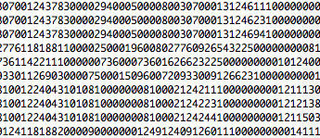
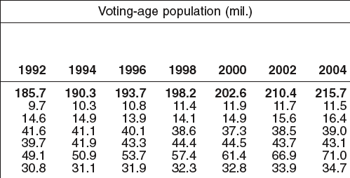
Data
Statistics

Slide 11
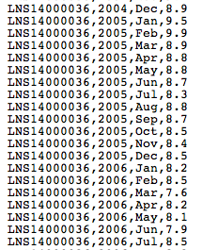
Data
AGGREGATE DATA
Statistics

Slide 12
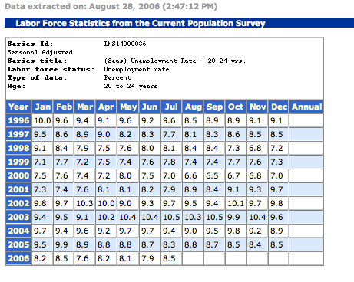
http://www.bls.gov/

Slide 14
8.1
7.9
8.5
8.1
7.9
8.5

Slide 15
Typical Characteristics of Aggregate Data
Contrast with microdata (lowest level of observation, e.g., person, firm, event)
Summarize microdata over time or space.
Allow comparisons between geographic areas or across time
File formatted for easy use by statistical software.

Slide 16
Some Typical Aggregate Data
Census data ("summary files")
Economic data (time series)
Business data (company or industry aggregates)

Slide 17
The real world

Slide 18
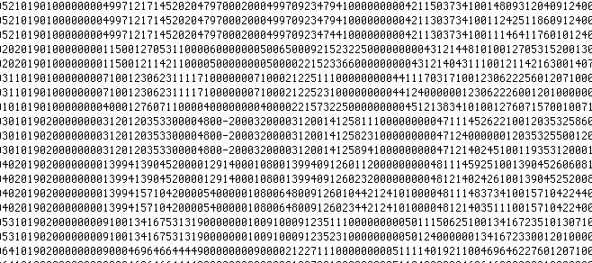
Data (microdata)

Slide 19
Aggregate Data

Slide 20
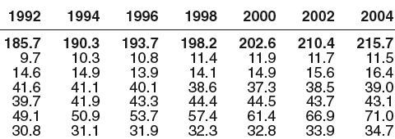
Statistical tables

Slide 21
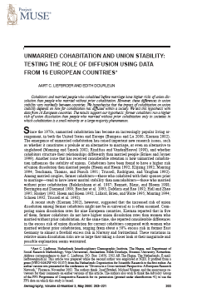
Scholarly literature

Slide 22
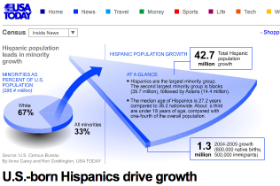
Popular press

Slide 23
Continuum of access
Microdata
Confidential microdata
Public use microdata
Aggregate data
Databases
eTables (digital, tabular, on the web or on CD, etc.)
ePublications (on the web or CD. Reports, statistical abstracts, etc.)
Scholarly publications
Popular press

Slide 24
Frameworks of statistical information

Slide 25
Continuum of access
Confidential microdata
Aggregate data
Scholarly literature
eTables
Public use microdata
databases
popular press
ePublications

Slide 26
Continuum of access
Confidential microdata
Aggregate data
Scholarly literature
eTables
Public use microdata
databases
popular press
ePublications
data
(CONTENT)
statistics

Slide 27
Continuum of access
Confidential microdata
Aggregate data
Scholarly literature
eTables
Public use microdata
databases
popular press
ePublications
data
(CONTENT)
statistics
less
(INDEXING)
more

Slide 28
Continuum of access
Confidential microdata
Aggregate data
Scholarly literature
eTables
Public use microdata
databases
popular press
ePublications
data
(CONTENT)
statistics
less
(INDEXING)
more
expensive
(COSTS)
free

Slide 29
Continuum of access
Confidential microdata
Aggregate data
Scholarly literature
eTables
Public use microdata
databases
popular press
ePublications
data
(CONTENT)
statistics
less
(INDEXING)
more
expensive
(COSTS)
free
restricted
(ACCESS)
open

Slide 31
Access Points
News.google.com
Lexis/Nexis
Newsbank
Factiva
Proquest
Etc…
Popular Press

Slide 32
Access Points
Scholar.google.com
Discipline indexes (Population Index, EconLit, PAIS, Sociofile, etc.)
Collection indexes (Muse, World Development Sources, Criminology, etc.)
Scholarly Literature

Slide 33
Access Points
Statistics
Statistical Universe
Statistical compendia and abstracts
Bibliographies of statistical publications

Slide 34
Access Points
Aggregate data
Aggregate data distributors
Fedstats: fedstats.gov
American Factfinder: factfinder.census.gov
International Financial Statistics: imfstatistics.org
Rand California: ca.rand.org
United Nations Common Database: unstats.un.org/unsd/cdb
Bureau of Labor Statistics: stats.bls.gov

Slide 35
Access Points
Microdata
Data Archives and Data Libraries
ICPSR: www.icpsr.umich.edu
UK Data Archive: www.data-archive.ac.uk
Council of European Social Science Data Archives: www.cessda.org/
History Data Service: hds.essex.ac.uk
American National Election Studies: http://www.electionstudies.org
Association of Religion Data Archives: thearda.com
NARA: www.archives.gov/research/electronic-record

Slide 36
Tip: use the tools you know to find statistics that will lead you to data
Bibliographic indexes (OPACs for books and data, journal indexes, news indexes, statistical indexes)
Web search engines
"Agency" approach (who might have collected the data?)
Known compilations of statistics
Known data sources, archives, libraries

Slide 37
Tip: work "backwards" from statistics to the data source
Footnotes
Bibliography
Captions under tables and graphs
text

Slide 40
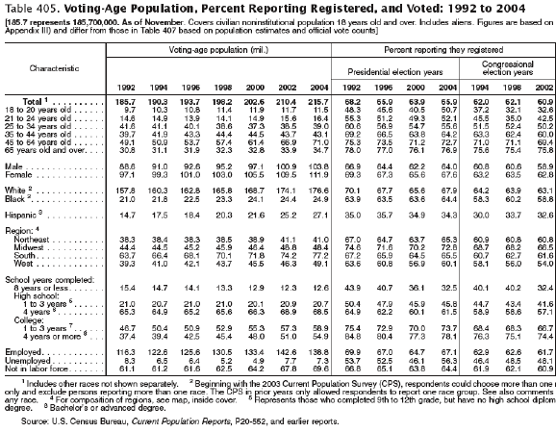

Slide 41
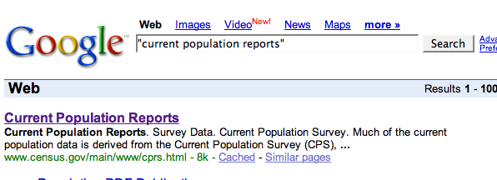

Slide 42
http://www.census.gov/prod/www/abs/p20.html

Slide 43
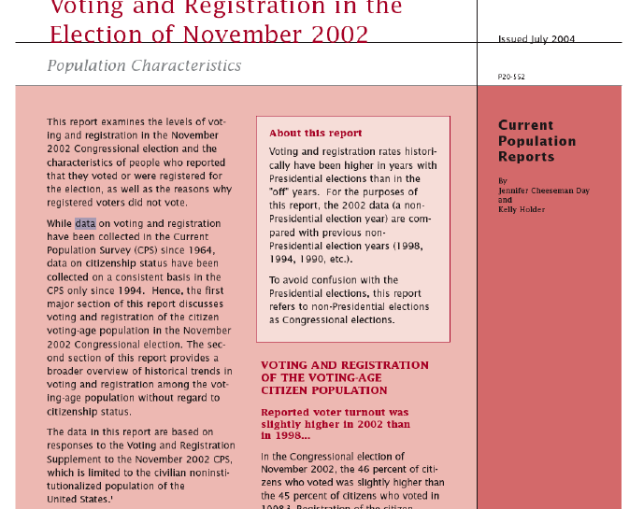

Slide 44
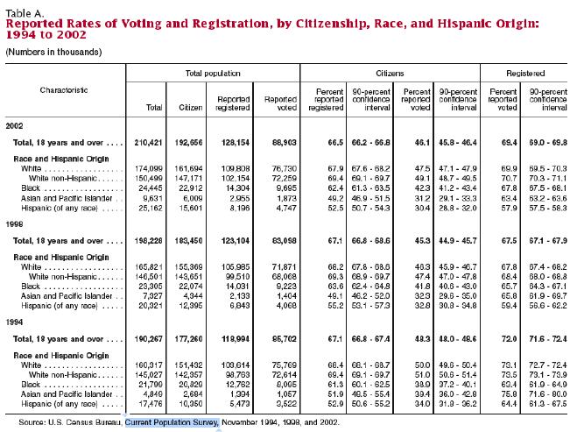

Slide 45
Tip: there is no one-and-only right way to begin a search for data
Ask 3 data librarians where to start a data-search and you'll probably get 3 different answers.
Each reference provider brings his or her own skills and experiences, knowledge and strategies.
Corollary: There may be many right end points of a search.

Slide 46
What we know…
Data come from surveys and administrative records
Statistics come from data
Aggregate data are summaries of microdata formatted for use by statistical software
The "continuum of data access" provides many entry points for searching for data.
The "best" search starts with tools that are familiar and may lead to statistics first.
By asking the right questions of users, we can focus in on the best starting points that are most likely to yield results that will fit the user’s needs. (5 minutes or less!)

