Slide 1
User Services
Focus, value and attitude
Vocabulary stories: wash & wear, circ & dingo
Statistics and data

Slide 2
Statistics are ubiquitous
“Statistics are generated today about nearly every activity on the planet. Never before have we had so much statistical information about the world in which we live. Why is this type of information so abundant? For one thing, statistics have become a form of currency in today’s information society. Through computing technology, society has become very proficient in calculating statistics from the vast quantities of data that are collected. As a result, our lives involve daily transactions revolving around some use of statistical information.”
Data Basics, page 1.1
Notes:
I’ve included a quote from the first chapter in Data Basics that was distributed to you last week. We live in a measured world; in a quantifiable world. Statistics are used to indicate performance levels, status or the value of things in daily life. They are used to make decisions about things that impact the quality of our lives as well as the safety of our lives. I mentioned in this chapter the story about a plane crash in Ontario a couple of years ago that was caused by a weight load that was too large for take-off. This accident led to a federal agency recalculating an average weight for passengers to determine weight loads on aircraft.
Much of our service in the library is shaped by the statistics that we gather about our collections and about the use of our services. Staffing decisions for service points are based on usage and traffic statistics, for example. LIBQual is an annual users’ survey that taps areas of service with which users are pleased or unhappy. The results from this survey have become weathervanes for managers as they decide how to improve services.
Some people react to statistics as something to fear. But we shouldn’t find statistics scary. They have an impact on our daily lives and, as a result, we need to understand them better. Personally, I find Paris Hilton much scarier than statistics.

Slide 3
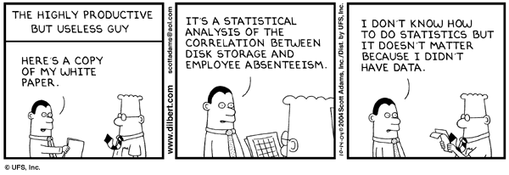
Statistics: what are we talking about?
Statistics and data are related but different

Slide 4
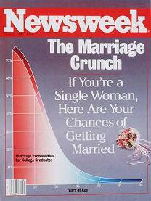
A statistic can’t be real without data
A ‘real’ statistic requires a data source. If the publisher of a statistic can’t tell you the data source behind a statistic, you should question that the statistic is ‘real.’ After all, people do make up statistics.
Classic example: a statistic in a 1986 Newsweek article claimed that a 40-year-old woman had a better chance of being killed by a terrorist than of getting married (2.6 percent). Twenty years later, Newsweek admitted that this “comparison wasn’t in the study.”

Slide 5
A statistic can’t be real without data
A statistic may have been derived from poor quality data and, consequently, may be of questionable value. But nevertheless, it is a ‘real’ statistic.
For example, a debate erupted over a Lancet article on the number of civilian deaths in Iraq following the first 18 months after the invasion.
The desire is to have quality statistics that are derived from quality data.

Slide 6
Quality of data, quality of statistics
Data producers use one set of criteria to ensure that the data are of high quality
Producers of statistics also use criteria to ensure that the statistics are of high quality. This is contingent upon having accurate, complete metadata.

Slide 7
Statistics Canada’s criteria
Statistics Canada uses the following criteria to define quality statistics or “fit for use”
Relevance: addresses issues of important to users
Accuracy: degree it describes what it was designed to measure
Timeliness: the delay between when the information was collected and when it is made available
Accessibility: the ease to which the information can be obtained by users
Interpretability: access to metadata that facilitates interpretation and use
Coherence: the fit with other statistical information through the use of standard concepts, classifications and target populations

Slide 8
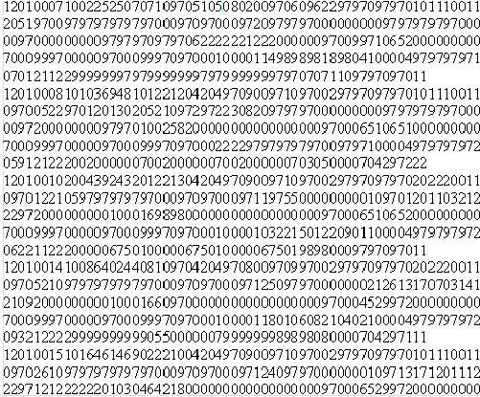
How statistics and data differ
Statistics
Numeric facts & figures
Derived from data, i.e, already processed
Presentation-ready format
Published
Data
Numeric files created and organized for analysis or processing
Require processing
Not display-ready
Disseminated, not published
Notes:
I have divided numeric information in the library into two general categories: statistics and data. This is an important distinction. Far too often, you will find people using the terms “statistics” and “data” interchangeably. But we won’t. They have very different meanings and purposes.
First, statistics are the compilations of numeric facts and figures that are readily available in print and electronic format. These facts and figures are created from data and are organized for human consumption. That is, they are display- ready and appear in tables, charts, graphs or maps.
Data, on the other hand, is the raw information from which statistics are derived. Data are stored in computer files and organized in structures that support their analysis or processing. Unlike statistics, which have been organized for presentation, data are not display-ready.
The examples here show a table representing the number of smokers in Canada and the a few records upon which this table was built. Let’s look at these two items in a bit more detail.

Slide 9
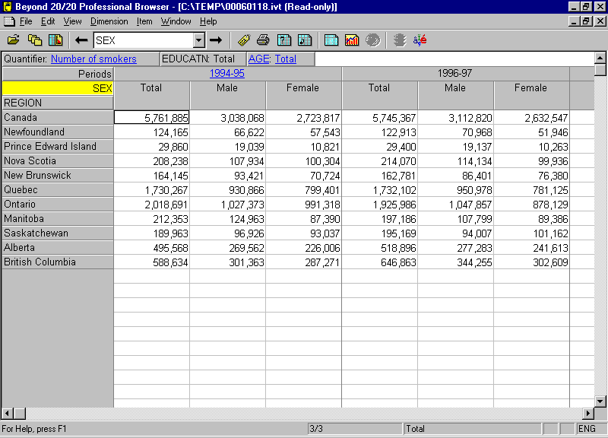
How statistics and data differ
Notes:
Statistics are derived from data! All the characteristics in this table have to represented in the data.

Slide 10
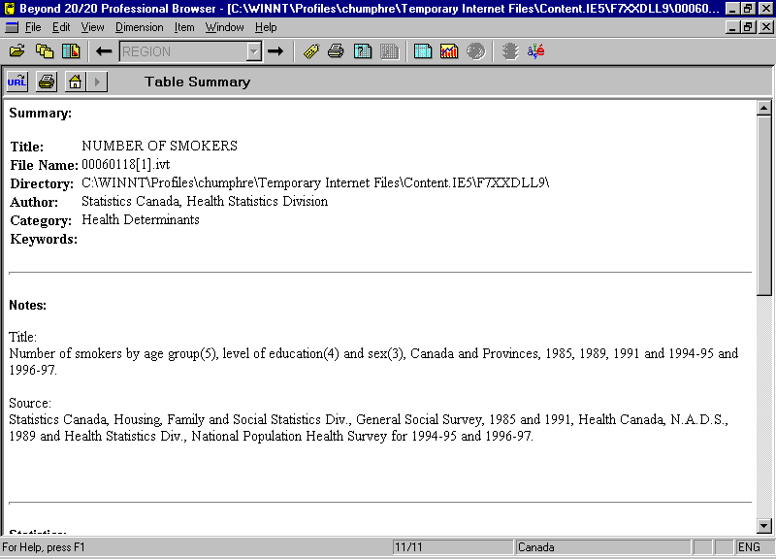

Slide 11
How statistics and data differ

Slide 12
Stories are told through statistics
The National Population Survey used in this example had over 80,000 respondents in 1996-97 sample and the Canadian Community Health Survey in 2005 has over 130,000 cases. How do we tell the stories about each of these respondents?
We create summaries of these life experiences using statistics.
Notes:
You’ve just seen an example of the records contained in the National Population Health Survey. In the 1996-97 survey, there were over 80,000 respondents. They provide a rich description of the status of population health characteristics in Canada, each one having a story to tell. The Canadian Community Health Survey in 2005 has over 130,000 stories to tell. The challenge is: How do you tell this many stories? Are they all unique or are there commonalities in the stories to be told? The answer is that we use statistics to summarize life experiences. We tell the stories in the aggregate and not at the level of each individual.

Slide 13
Statistics are about definitions
Notes:
Statistics are derived from data, i.e., if they are real statistics and not fabrications. An essential step in creating statistics, as you experienced from the previous exercises, is organizing the data into meaningful categories or summary measures that help tell a story. Fundamental to this is defining the categories or measures used to create the statistics. In other words, statistics are about definitions.
You can clearly see that the point-haired manager in Dilbert clearly understands that statistics are about definitions. He didn’t get the industry salary averages that he wanted. So, he changed the definition of his industry in include high technology, textile workers, teen-agers and dead people.

Slide 14
Definitions and metadata
Users of statistics require complete, accurate metadata to understand the statistics.
All of the definitions and information that describe the unit of observation, the universe, the sampling method, the concepts and the variables are critical to understand both the data and the statistics derived from the data.

Slide 15
Dimensions of statistics
Geography
Region
Time
Periods
Unit of Observation Attributes
Smokers
Education
Age
Sex
The cells in the table are the number of
estimated smokers.
Six dimensions or variables in this table
Notes:
Let’s look at the table shown two slides earlier in more detail. First, it is being viewed in the Beyond 20/20 table browser, a proprietary program first introduced by Statistics Canada with the 1996 Canadian Census. How many of you are familiar with Beyond 20/20? Let’s have a show of hands. We’ll come back to Beyond 20/20 if you have questions about it later in the workshop. This is a very helpful tool and can help organize the display of statistical information.
For the time being, notice the following characteristics of this table. First, the numbers in the cells of the table represent estimated counts of the number of smokers. Along the rows of the table are standard geographic areas for Canada: a national total and the ten provinces. The territories are missing from this table. The columns are organized around two year groupings. First, there is a summary for 1994-95; secondly, there is another grouping for 1996-97. Under each of the yearly groupings is a breakdown for males and females. At the top of the table, we see two more characteristics that have been held constant: education and age. This table could be displayed in different ways.
One defining property of statistical tables is that almost all are built around three basic concepts: geography, time and attributes of the unit of observation, i.e., the object that was observed in collecting the data. In this case, geography is represented by Region; time is represented by the two time periods; and the attributes of individuals are smoking behaviour, education level, age and sex.

Slide 16
Statistics involve classifications
The definitions that shape statistics specify the metric of the data they summarize (for example, Canadian dollars) or the categories used to classify things if a statistic represents counts or frequencies. In this latter case, classification systems are used to identify categories of membership in a concept’s definition.
Some classification systems are based on standards while others are based on convention or practice.
For an example of a standard, see the North American Industrial Classification System (NAICS).

Slide 17
Statistics are presentation ready
Tables and charts (or graphs) are typically used to display many statistics at once. You will find statistics sprinkled in text as part of a narrative describing some phenomenon; but tables and charts are the primary methods of organizing and presenting statistics.

Slide 18
Validating statistics
Validating the source of the statistic
Finding the origin of the published statistic
Finding the data source
Reproducing a statistic from its source
Using the data source to reproduce the statistic

Slide 19
Globe and Mail editorial
“Here is the trendline: In 1959, Gallup asked Americans whether there should be a law banning the possession of handguns except by police and other authorized persons; 60 per cent said yes. In 2011, 26 per cent replied in the affirmative.”
Ideas for validating this statistics?

Slide 20
Globe and Mail editorial
Gallup Brain
iPOLL

Slide 21
Lifecycle of survey statistics
1
1 | Program objective
2 | Survey unit organized
3 | Questionnaire & sample
4 | Data collection
5 | Data production & release
6 | Analysis
7 | Findings released
8 | Popularizing findings
9 | Needs & gaps evaluation
9
2
3
8
4
7
6
5
Notes:
One way of looking at the “big picture” of statistical information is to think of it in terms of a life cycle. Now, life cycle is not the same thing as life span, which runs the course from cradle to grave. Life cycle consists of a series of stages in which things are transformed moving from stage to stage or through different states but are not inherently lost. The life cycle of water is an example of this type of model. Water evaporates to form clouds, which results in snow and rain that falls back to earth and is collected and once again evaporates.
If we properly manage statistical information, it too should take on different states and not disappear in the long run. But more about that in a moment. Let’s first look at the model shown here. This particular version of the statistical information life cycle is based on an agency collecting information to support its operations. The cycle begins with a need for information based on a program objective. The resources to produce this information are organized in stage 2. In stage 3, using survey methdology, a sample is drawn and a questionnaire developed to capture information from a level at which the information can be observed. The questionnaire is usually pre-tested to see that it is measuring the information that is wanted and then data collection from the full sample is conducted in stage 4. As the data are gathered, they are organized for analysis in stage 5 and once completed, the data are released for analysis in stage 6. Stage 5 might consist of a couple different releases of the data. For example, a confidential version of the data might be made available internally, while a public use version that anonymizes the data may follow at a later date. In stage 7, statistical results are released. This may be through a very official process or some kind of peer review of findings. Stage 8 consists of the popularizing of the results in a wider range of media. Stages 7 & 8 are part of the knowledge transfer process. In stage 9 the information is used to support the program for which it was created. At some point, the use of this information will be assessed and gaps in the information or new needs may be identified which results in modifying the objectives for collecting the information and the cycle is repeated. Or the cycle may be repeated because a new time period requires the production of the information again.
[Click for Access to Information]
Now a couple comments about the management of the information produced in this life cycle model. Libraries play an important role in providing access to this information and not just the statistics in the later stages of the life cycle. We collect and manage information about program objectives, about the process of gathering data; we now collect public use versions of the data and provide access to the confidential data through services such as Research Data Centres. We have long been responsible for gathering the outputs containing statistics, initially in print but increasingly in digital formats. And we manage the reports emanating from the services for which the statistical information was created to support.

Slide 22
Lifecycle applied to health statistics
1 | Program objectives
 | increased emphasis on health promotion and disease prevention;
 | decentralization of accountability and decision-making;
 | shift from hospital to community-based services;
 | integration of agencies, programs and services; and
 | increased efficiency and effectiveness in service delivery.
1
9
2
3
8
Health Information
Roadmap Initiative
4
7
6
5
Notes:
We are going to use the Health Information Roadmap Initiative as an example of looking at a life cycle of statistical information. As Federal and provincial health ministries began to struggle with both the costs of health care and the demands on the health system, they ended the 1990’s and started the new decade with a plan to monitor better population health characteristics that have an impact on the health system and the performance of the health system under increased demand for services. Through a series of consultations in 1998 with ministries of health, a roadmap was developed and implemented in 2000.
The link to the Health Information Roadmap Initiative takes you to the CIHI website where you will find supporting documents.
This roadmap emerged at a time when the following objectives were common across jurisdictions: “Although the context differs among jurisdictions, the major objectives are similar, and include:
• increased emphasis on health promotion and disease prevention;
• decentralization of accountability and decisionmaking;
• shift from hospital to community-based services;
• integration of agencies, programs and services; and
• increased efficiency and effectiveness in service delivery.” page 1 of Health Information Needs in Canada.

Slide 23
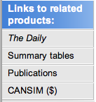
Lifecycle applied to health statistics
1
2 | Survey unit organized
3 | Questionnaire & sample
4 | Data collection
5 | Data production & release
6 | Analysis
7 | Official findings released
9
2
3
8
Health Information
Roadmap Initiative
4
7
6
5
Notes:
From the perspective of population health indicators, Health Canada and Statistics Canada built upon an existing survey, the National Population Health Survey, to create the Canadian Community Health Survey (CCHS). They increased the sample size to allow for accurate estimates down to provincial health authorities. Most STC surveys allow estimates only to the CMA and provincial levels. Thus in our life cycle, STC is responsible for stages 2 through 7. The Health Statistics Division took on responsibility for the CCHS, which is conducted in a rotation cycle. Every two years is a large sample of around 130,000 Canadians; between these years is a smaller sample of around 30,000 Canadians that focuses on a specific health issue.
The link from “Survey unit organized” takes you to Statistics Canada’s list of health surveys. If you select the CCHS or click on the link from “Questionnaire & sample”, you will find information about the CCHS in the Integrated Metadata base System (IMDB), which is built on the old SDDS inventory of surveys. The link on the CCHS IMDB page on the left menu to “Other Reference Periods” shows the history of CCHS cycles.
[Click to bring in Links to related products]
A variety of findings are available from the Link to related products, again in the left-hand menu. We’ll come back to this website later in the workshop.
The findings from the CCHS have been carried widely in the popular press and magazines. And stage 9 is evident from the Health Indicators used by the ministries of health. [Click on link to Links to related products to get to Health Indicators].

Slide 24
Reconstructing statistics
One way to see the relationship between statistics and the data upon which they were derived is to reconstruct statistics that someone else has produced from data that are publicly accessible.
Notes:
We are going to explore the relationship between statistics and the data upon which they were derived by reconstructing some findings about Canadian drinking behaviour reported in an article from the Spring 1996 issue of Canadian Social Trends. These statistics were come from the National Population Health Survey, 1994-95, which is the same data source used in the table we just observed containing estimates of the number smokers in Canada.
You are invited to follow along as I work my way through this demonstration. You have a handout with a script outlining the steps that I will be following to replicate these statistics. If you wish, you can click along with me or you can sit back and watch.

Slide 25
Reconstructing statistics
1
1 | Program objective
2 | Survey unit organized
3 | Questionnaire & sample
4 | Data collection
5 | Data production & release
6 | Analysis
7 | Official findings released
8 | Popularizing findings
9 | Needs & gaps evaluation
9
2
3
8
Health Information
Roadmap Initiative
4
7
6
5
Notes:
In a sense, we are going to follow the life cycle for the 1994-95 NPHS in reverse. We’ll start with a finding in the Spring 1996 issue of Canadian Social Trends. This is a newsy article containing a series of highlights from the survey and intended for the general Canadian population. Applying our life cycle model, we are moving from Stage 8 back to Stage 5, where the public use version of the data and its documentation were disseminated. And our final step backwards in the life cycle will be to trace variables from the data to the questionnaire in Stage 3.

Slide 26
Reconstructing statistics
The statistics that we will reconstruct are reported in “Health Facts from the 1994 National Population Health Survey,” Canadian Social Trends, Spring 1996, pp. 24-27.
The steps we will follow are:
identify the characteristics of the respondents in the article;
identify the data source;
locate these characteristics in the data documentation;
find the original questions used to collect the data;
retrieve the data; and
run an analysis to reproduce the statistics.
Notes:
We’ll begin our task by identifying a specific finding in the CST article that we’ll try to reconstruct. The steps will be to identify in the article the characteristics about the respondents reported in the article. That is, what has been summarized about the respondents in this story. We’ll see if the article provides us with a way of identifying the data source. Is there a title of a product that will help? Have data been specifically mentioned? Once we have data, can we find documentation for the data file? Can we find the characteristics in the article in the data documentation? Can we find the original questions used to collect these characteristics? Once we have navigated through these steps, we’ll retrieve a copy of the data and reproduce the statistics.

Slide 27
The findings to be replicated
Page 26
Notes:
On page 26 of the article, there is the heading: Men more likely to drink. [Read section] The statistics that we will reconstruct are reported in this section.
What kind of statistics will we reconstruct? Are they population estimates? Averages? Totals? No, the statistics we will be reconstructing are percentages. For example, 58 percent of adult Canadians are current drinkers.
The first step is to identify the variables in these findings. What is being described? Look at the nouns and verbs and see if you can find what is being described.
[Click] First, these findings are for “adult Canadians”. Therefore, we know that we won’t be including children in this analysis. The question remains to be seen at what age we consider adulthood. We can check the documentation to see if a variable identifies adults from children or if we have to use age.
[Click to clear] [Click] Next, there is a drinking type identified as “current drinkers.” [Click] In fact, a definition for current drinkers is provided: anyone who has consumed alcoholic beverages at least once a month. That may seem to be a bit loose of a definition for current for you, but we at least know how they have defined it.
[Click to clear] [Click] Next we notice that different statistics are reported for men and women. We’ll need a variable to identify each gender.
[Click to clear] [Click] Four different age categories have been mentioned. We’ll need to see if these age categories exist in the data or if actual age has been given.
[Click to clear] [Click] A variable to identify smokers will be needed.
[Click to clear] [Click] Finally, we see more of the categories associated with type of drinkers.

Slide 28
Summary of variables identified
Findings apply to Canadian adults
Likely need age of respondents
Men and women
Look for the sex of respondents
Type of drinkers
Look for frequency of drinking or a variable categorizing types of drinkers
Age
Look for actual age or age in categories
Smokers
Look for smoking status
Notes:
These are the characteristics in the article around with statistics were reported and the likely set of variables for which we need to look to represent these characteristics.
Record this information under 1A of the handout accompanying this computing exercise.
Variable Name AGEGRP
Question
Description Grouped Age Cohorts
Note Age of respondent - grouped
Content Code Sample Population
12 TO 14 YEARS 1 637 1,326,126
15 TO 19 YEARS 2 1,210 2,046,276
20 TO 24 YEARS 3 1,395 1,739,548
25 TO 29 YEARS 4 1,587 2,139,891
30 TO 34 YEARS 5 1,934 2,615,603
35 TO 39 YEARS 6 1,770 2,594,260
40 TO 44 YEARS 7 1,499 2,270,073
45 TO 49 YEARS 8 1,392 1,965,416
50 TO 54 YEARS 9 1,109 1,538,644
55 TO 59 YEARS 10 1,007 1,285,885
60 TO 64 YEARS 11 943 1,175,916
65 TO 69 YEARS 12 961 1,105,799
70 TO 74 YEARS 13 909 954,118
75 TO 79 YEARS 14 638 620,464
80 YEARS OR OLDER 15 635 570,586
17,626 23,948,605 Total

Slide 29
Identify the data source
Survey title is identified: National Population Health Survey, 1994-95
Public-use microdata file is announced
Page 25 of the article
Notes:
On page 25 of the article, a sidebar provides us with the title of the survey and who was included in the sample. It also informs us that a public use microdata file is available, which is useful to know. To move to stage 5 in our life cycle model, we’ll need a copy of the microdata to reconstruct the statistics in our article.
[Click on sidebar image] This will link to the STC Catalogue entry for 82F0001X, the NPSH 1994-95 public use microdata file.

Slide 30
Locate the variables
Examine the data documentation for the National Population Health Survey, 1994-95
PDF version is on-line
Use TOC and link to “Data Dictionary for Health”
Identify the variables from their content
NOTE: check how missing data were handled
Trace the variables back the questionnaire
Did sampling method require weighting cases?
NOTE: in addition to the other variables, is a weight variable needed to adjust for the sampling method?
Notes:
There are two products that we need to use with the microdata file. One is the documentation describing the data, while the other is the data file. The link on this slide opens a copy of the data documentation. Use the handout accompanying this exercise to work through these steps.

Slide 31
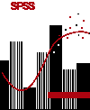
Retrieve and analyze the data
Make use of local data services to retrieve data from the NPHS.
Notes:
The microdata are licensed through the Data Liberation Initiative. Special permission from the author division has been received to use these data in this workshop.

Slide 32
Lessons from the NPHS example
This example demonstrates the distinction between producing statistics and interpreting statistics that have been published by others.
This is an important distinction because:
Choices are made in creating statistics.
Interpreting statistics requires an ability to understand the choices that were made.
Searching for statistics that others have published can be facilitated by understanding these points.

Slide 33
Search strategies for statistics
The government publications strategy is to identify an agency that might produce and publish such a statistic. This approach relies on knowledge of governmental structure and the content for which agencies are responsible.
The data strategy is to identify a data source from which the statistics could have been produced. This approach replies on knowledge of data sources collected by agencies.
Notes:
Now that we’ve distinguished between statistics and data and have discussed the importance of definitions in the production of statistics, let’s look at the sources for statistics. What are the origins of the data? These two graphs appears last fall in the Edmonton Journal. Interestingly, the sources for the statistics are given but the actual data source isn’t identified. The idea reporting would be to have named data sources.

Slide 34
The data strategy
What data source or sources would be used to produce such a statistic?
What unit of observation would be needed to produce such statistics?
What would the structure of the table look like given time, geography and attributes of the unit of observation?
Who would collect such data?
Would the source be an official agency?
Use the literature trail and its indexes to see if a data source can be found (official and non-official publications)

Slide 35
Framework

